Slide 1

Statistical Fundamentals:
Using Microsoft Excel for Univariate and Bivariate Analysis
Alfred P. Rovai
Pivot Tables
PowerPoint Prepared by
Alfred P. Rovai
Microsoft® Excel® Screen Prints Courtesy of Microsoft Corporation.

Slide 2
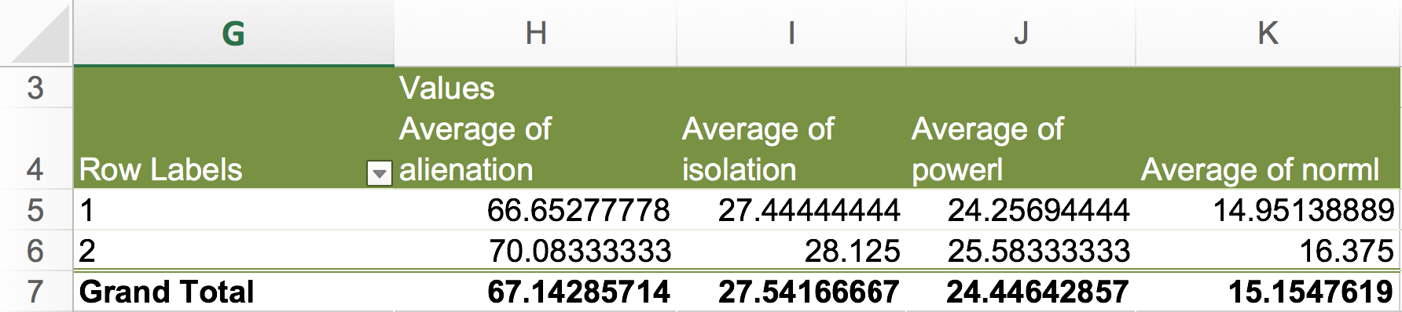
Pivot Tables
A pivot table is an Excel reporting tool that facilitates summarizing data without the use of formulas and displaying various statistics using different formats.
Below is an example of a pivot table that provides the means (arithmetic averages) for four variables (see grand totals) while also providing means for two categories (male = 1 and female = 2):

Slide 3
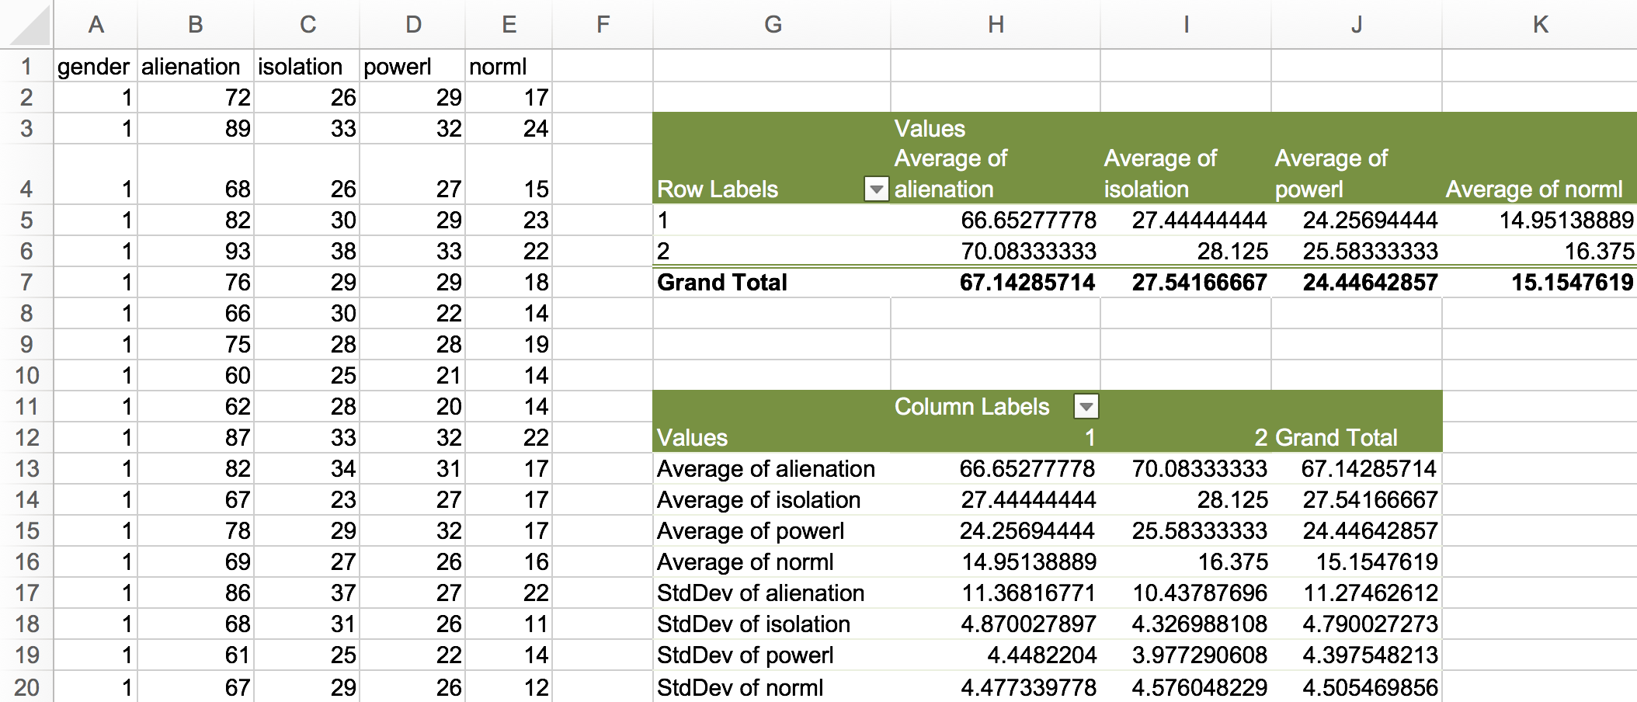
Constructing a Pivot Table
Open the dataset Motivation.xlsx. Click on the Pivot Table worksheet tab.
File available at http://www.watertreepress.com/stats
TASK
Construct a pivot table using the provided datset that:
Displays values as Averages of alienation, isolation, powerlessness (powerl), and normlessness (norml).
Displays gender (i.e., 1=male and 2=female) as row labels.

Slide 4
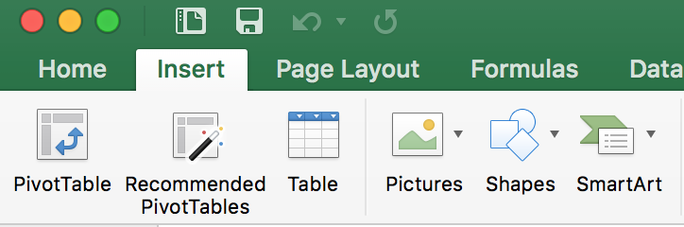
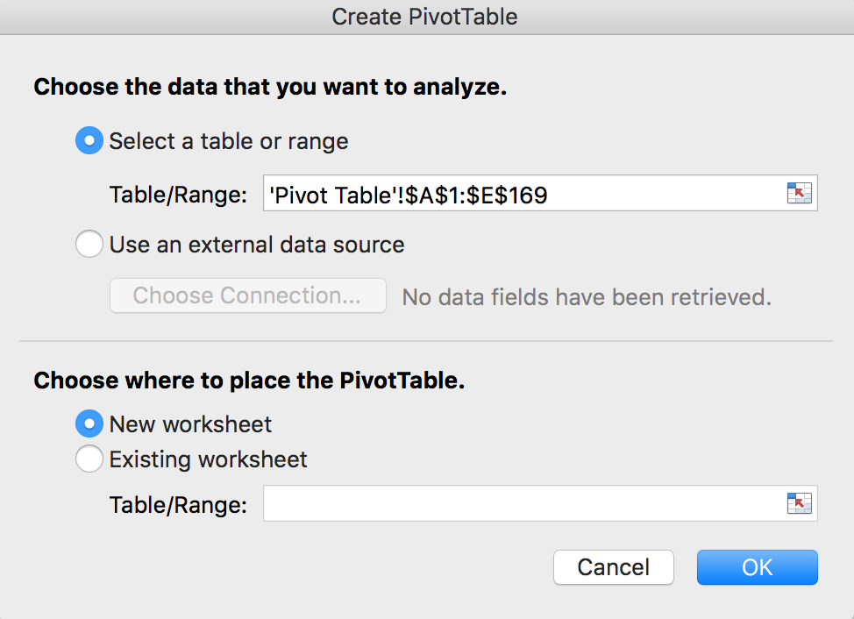
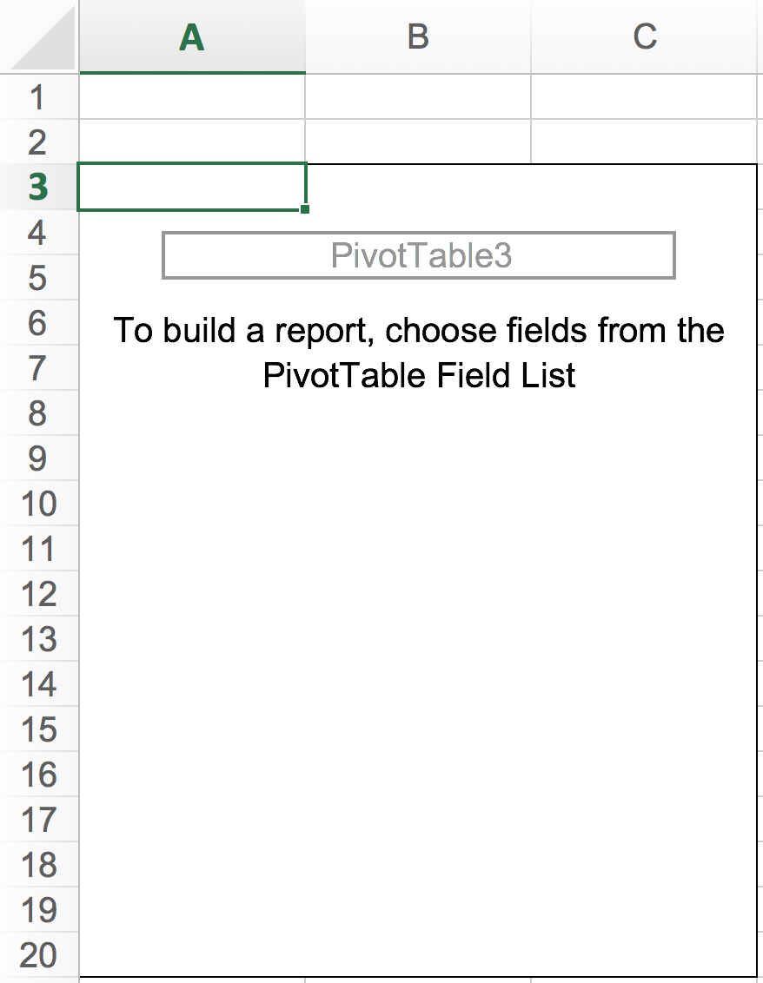
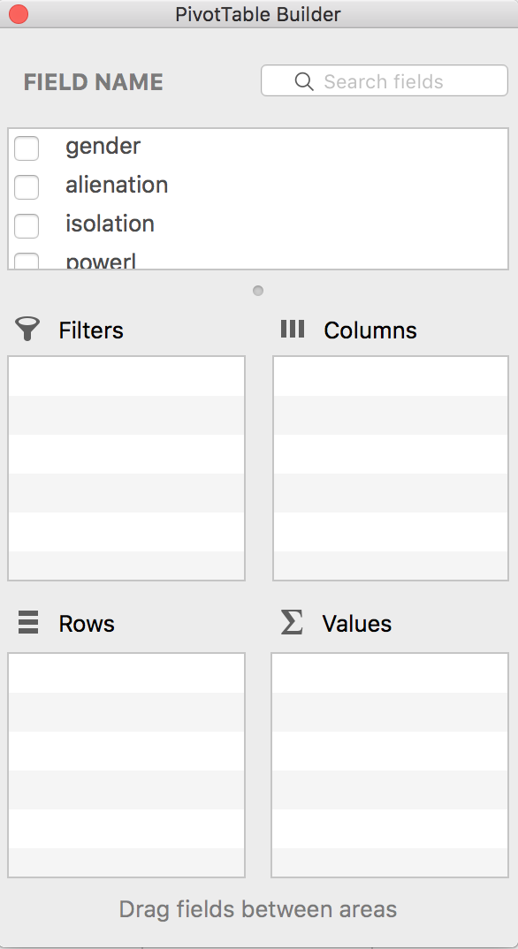
Constructing a Pivot Table
Click on a cell in the dataset to make it active, e.g., cell A1. Then proceed to the Excel Insert tab and click on the Pivot Table icon.
The Create Pivot Table dialog opens. Confirm/change the settings and click OK. A blank pivot table appears on the designated worksheet along with the PivotTable Builder dialog.

Slide 5
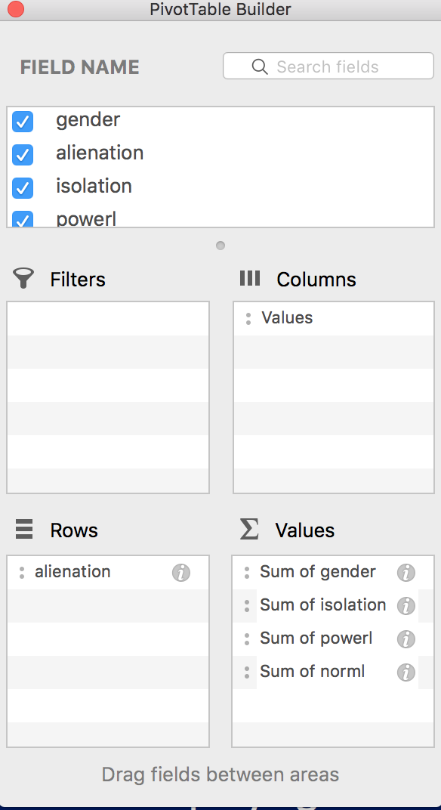
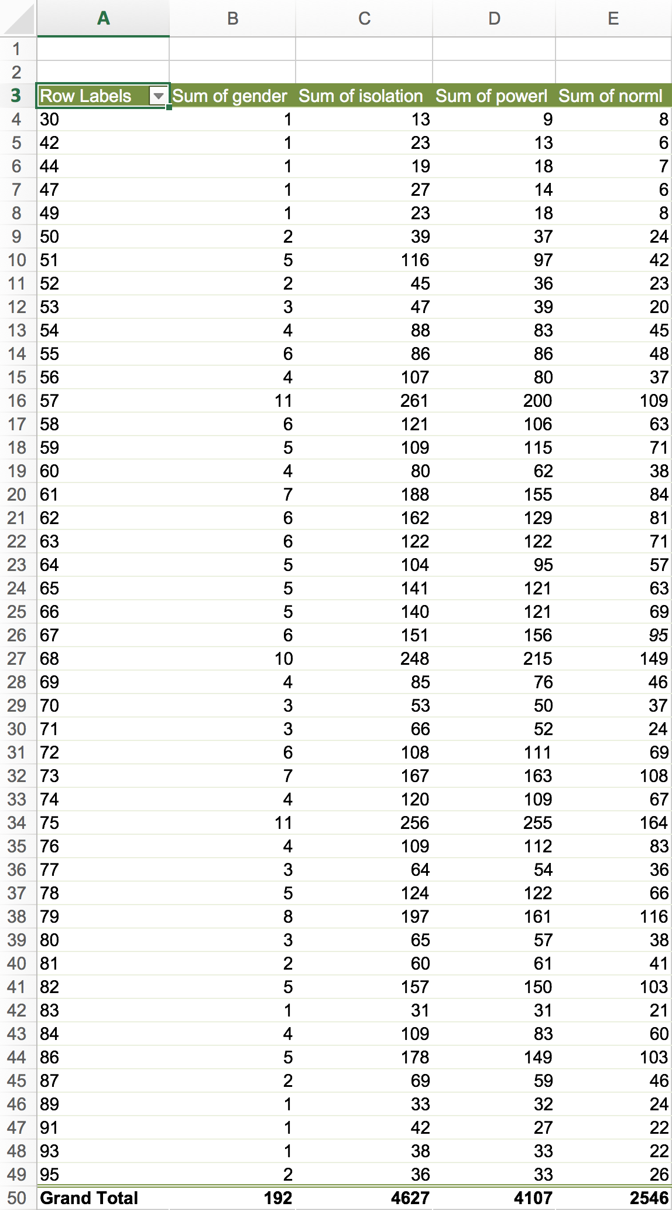
Constructing a Pivot Table
Using the Field Name panel, check gender, alienation, isolation, powerl, and norml. Notethe appearance of tiles in the Columns, Rows, and Values panel.
The pivot table changes to reflect the settings in the PivotTable Builder dialog. See below.

Slide 6
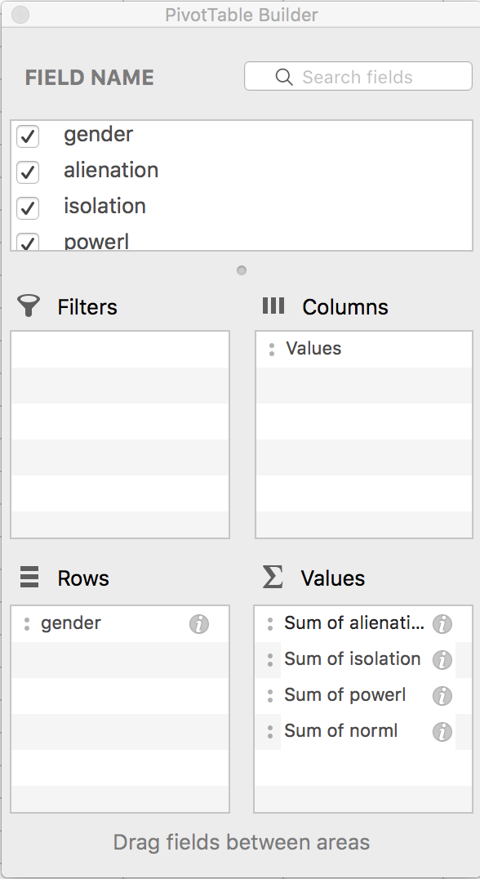
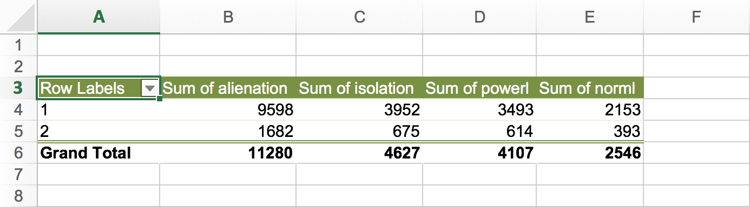
Constructing a Pivot Table
Drag the gender tile from the Values panel to the Rows panel; drag the alienation tile from the Rows panel to the Values panel.
The pivot table changes to reflect the settings in the PivotTable Builder dialog. See below.

Slide 7
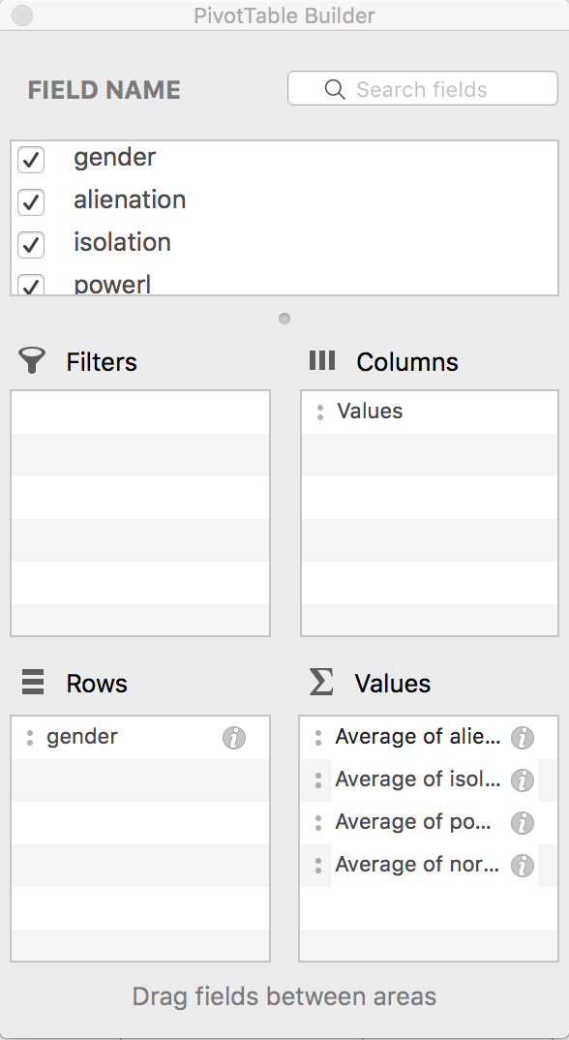
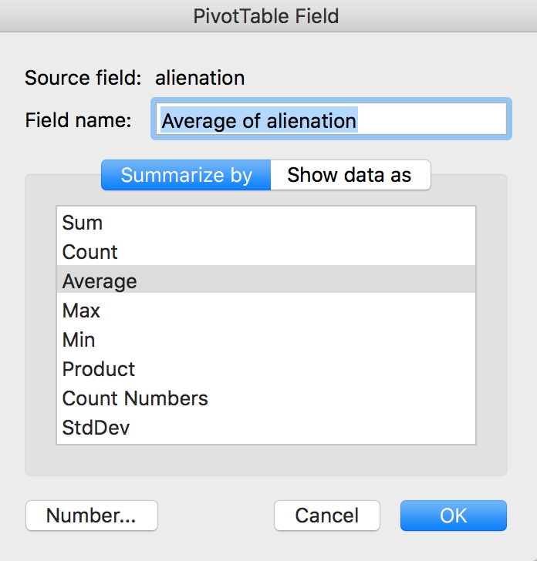
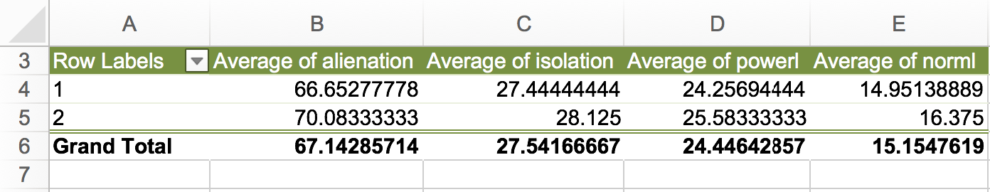
Constructing a Pivot Table
Click the “I” icon on each tile in the Values panel (in turn). Change each variable from Sum (default) to Average.
The pivot table changes to reflect the settings in the PivotTable Builder dialog. See below.

Slide 8
Pivot Tables
End of Presentation

